Slide 1
Java – Threads

Slide 2
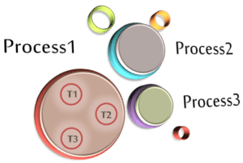
Threads in Java
What does a Process mean in Computer Science?
A process consists of a memory space allocated by the operating system that can contain one or more threads. The thread cannot exist on its own; it must be a part of a process. A process remains running until all of the non-daemon threads are done executing.
What does a Thread mean in Computer Science?
The thread is a lightweight sub-process and the smallest unit of execution.
Each thread has a separate path of execution.
It shares the memory area of the process.

Slide 3
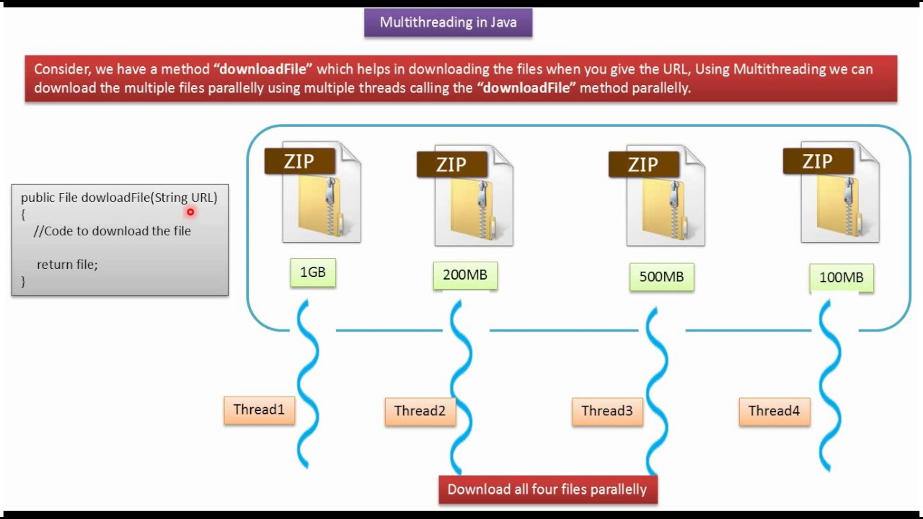
Threads in Java

Slide 4
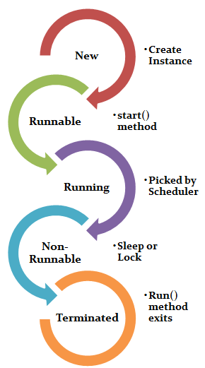
Thread LifeCycle In Java
New
Runnable
Running
Non-Runnable (blocked)
Terminated
New- A thread is in New state when you create the instance of thread class, but the start() method is yet to get called.
Runnable- The thread is in runnable after executing the start() method. In this stage, it waits for the thread scheduler to run it.
Running- A thread picked by the thread scheduler for execution remains in running state.
Non-Runnable (blocked)- In this state, the thread remains alive, but it is not eligible to run. It may be due to some sleep operation, waiting for any File I/O to finish or in the locked state, etc.
Terminated- A thread is said to be in the terminated state when it’s Run() method exits.

Slide 5
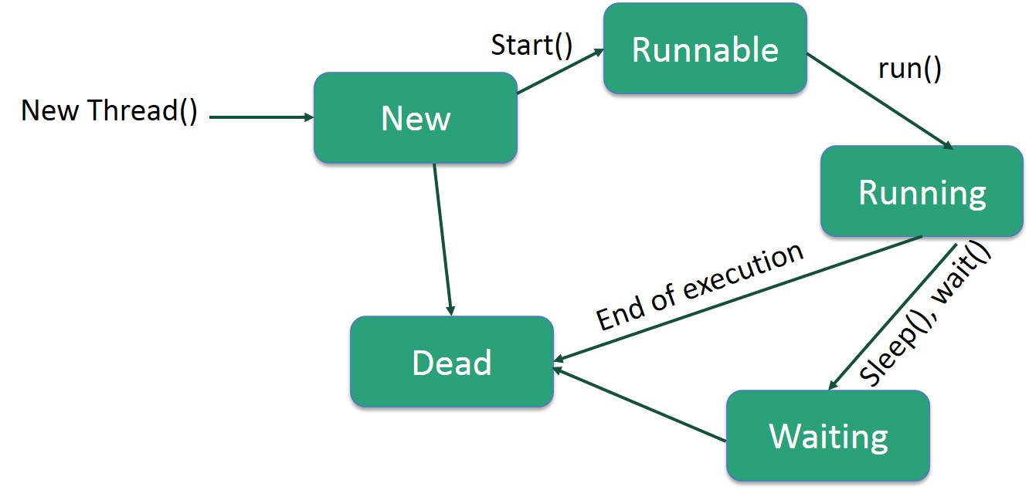
Thread LifeCycle In Java

Slide 6


